Slide 1
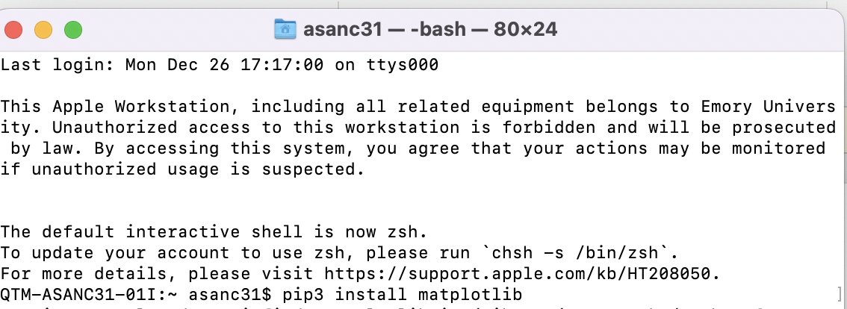
Step 0: Preliminaries
Step 1: Setup Working Environment
Step 2: Run Data Analyses
Import Packages
Open Data
Modify variables
Compute Statistics
Produce graphs or tables
Define Directory (optional)
Open Jupyter: Automatically initiates "Base Python"
Install new package in terminal (if necessary)

Slide 2
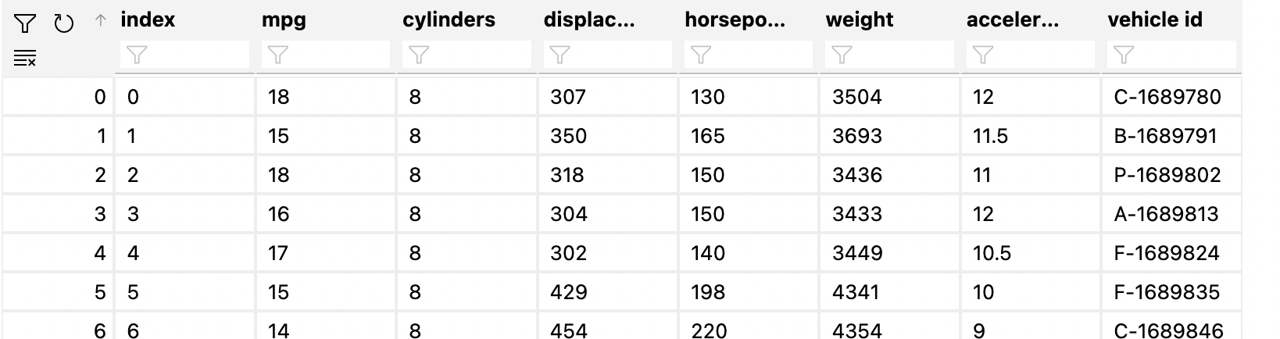

Slide 3
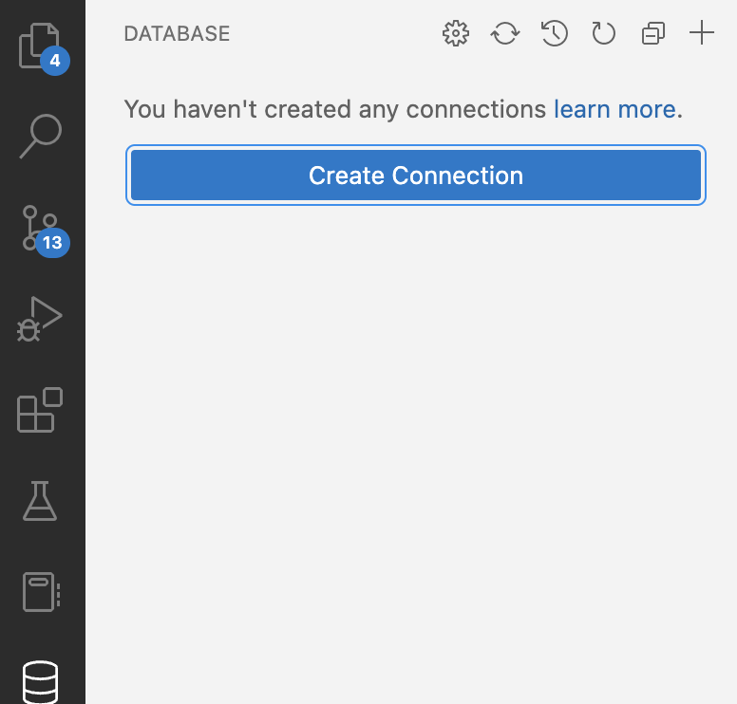
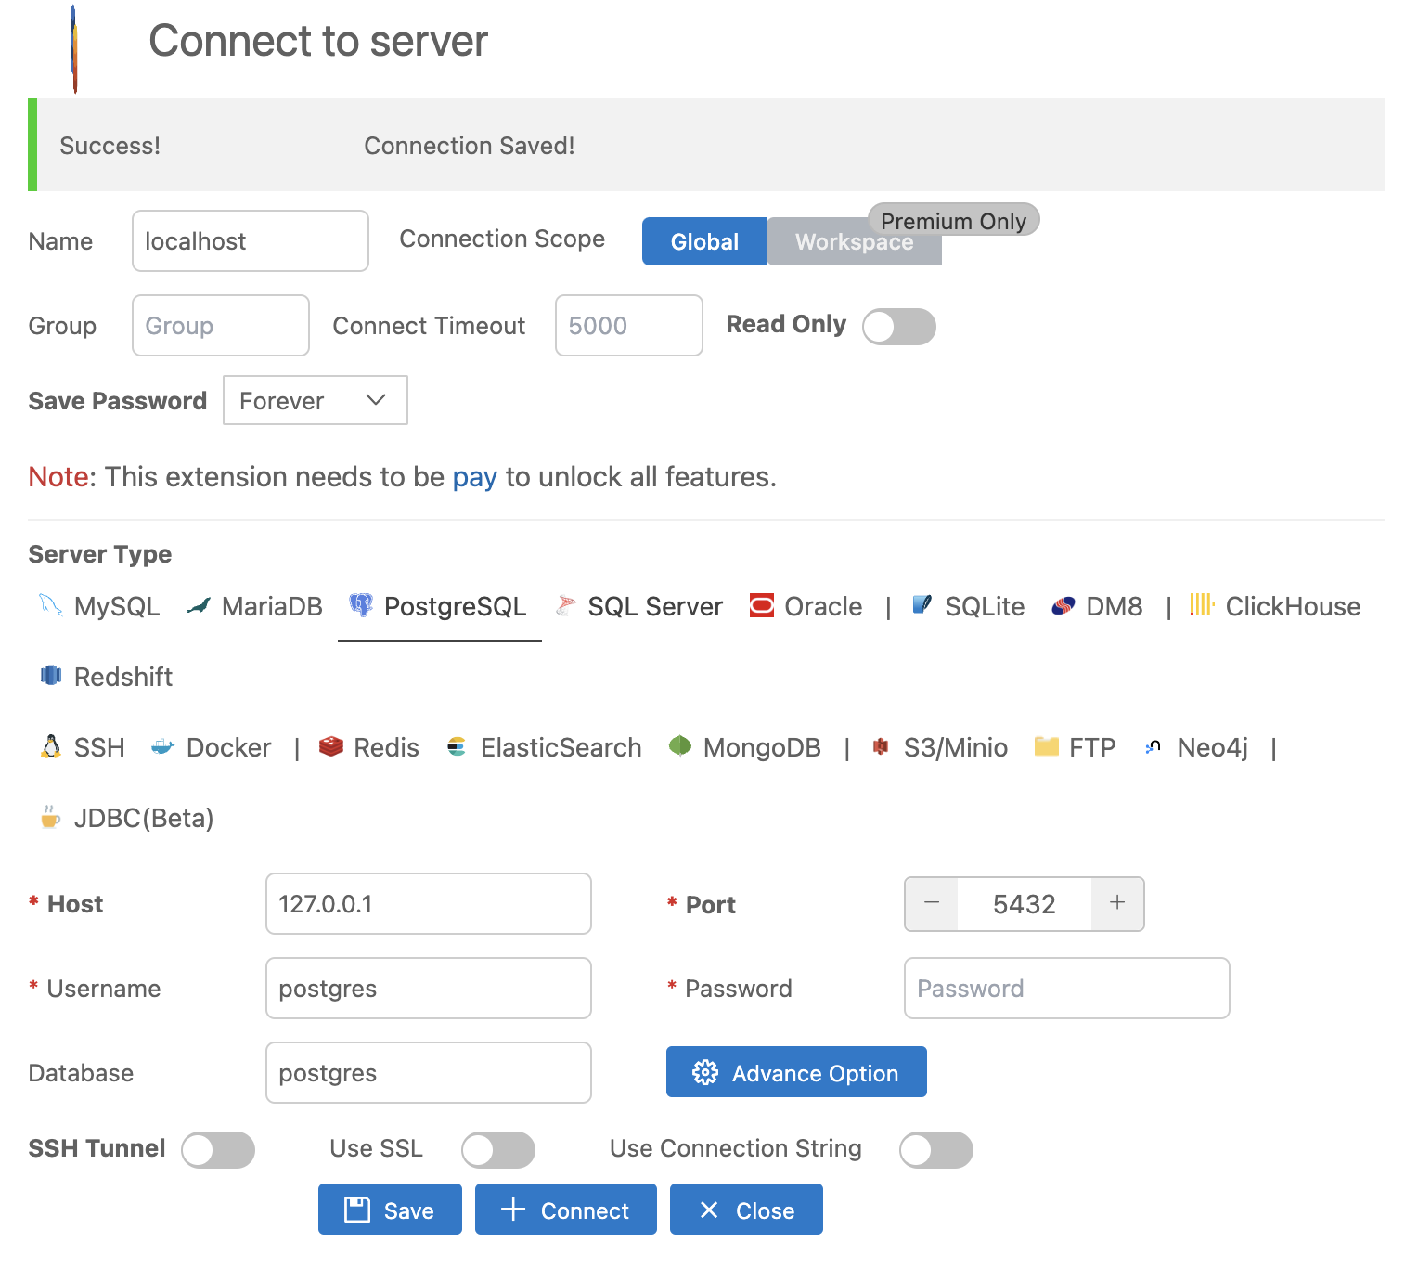
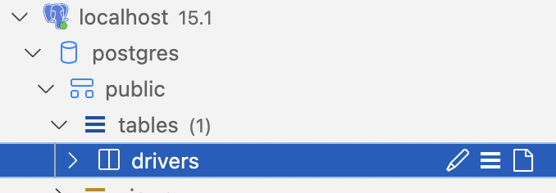
View Table

Slide 4
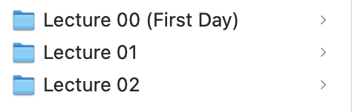
Floor 2
Lecture Order
Floor Order in the UK
Floor 1
Ground (0)

